Slide 1
PC Based Diagnostics Tool
Team 74

Slide 2
Team 74
Faculty Advisor
  Dr. Tragoudas
Project Manager
  Joseph Lenox (CE)
Team
  Douglas Palmer (EE)
  Tiffany Gallops (CE)
  Wesley Tredinnick (EE)

Slide 3
Outline
Executive Summary
Discussion
  PC Based Modular Diagnostics Tool
  Literature Review
  Plan to Complete
Work Completed (?)
The Plan to Complete (?)
Resources Required

Slide 4
Executive Summary

Slide 5
Discussion
PC Based Modular Diagnostics Tool
  A device that will combine the abilities of a multimeter, oscilloscope, and a logic analyzer.

Slide 6
Discussion
Literature Review
  <insert>

Slide 7
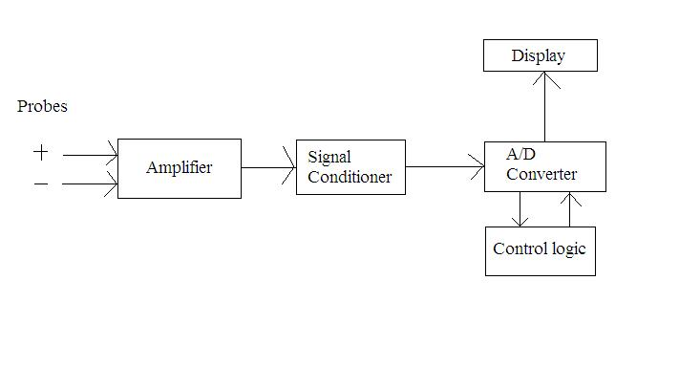
Multimeter subsystem
Will work in coordination with the oscilloscope and logic analyzer to acquire data
Will obtain data on the voltage, current, and resistance
Schematic design
will include
amplifier, ADC,
and control logic

Slide 8
Work Completed
<insert>

Slide 9
Plan to Complete
RASI

Slide 10
Plan to Complete
Time Line
  Week 1: Final Component Decision
  Weeks 2 & 3: Complete Schematics
  Week 4: Complete Design Verifications
  Week 6: PCB's Ordered, Test and Develop Software
  Week 8: Software Complete
  Week 9: Begin Construction

Slide 11
Resources Required
LabVIEW
Bluetooth Stack Module (WRL-08461)
Analog/Digital Converters
Printed Circuit Boards
Miscellaneous Hardware
Projected Cost: Approx. $500 material cost

